Slide 1

High Impact Skills Development Program
in Artificial Intelligence, Data Science, and Blockchain
Module 2: Data Science Fundamentals
Lecture 2: Identifying the Right Data: Strategies, Methods, and Impacts
Instructor: Eid Muhammad

Slide 2
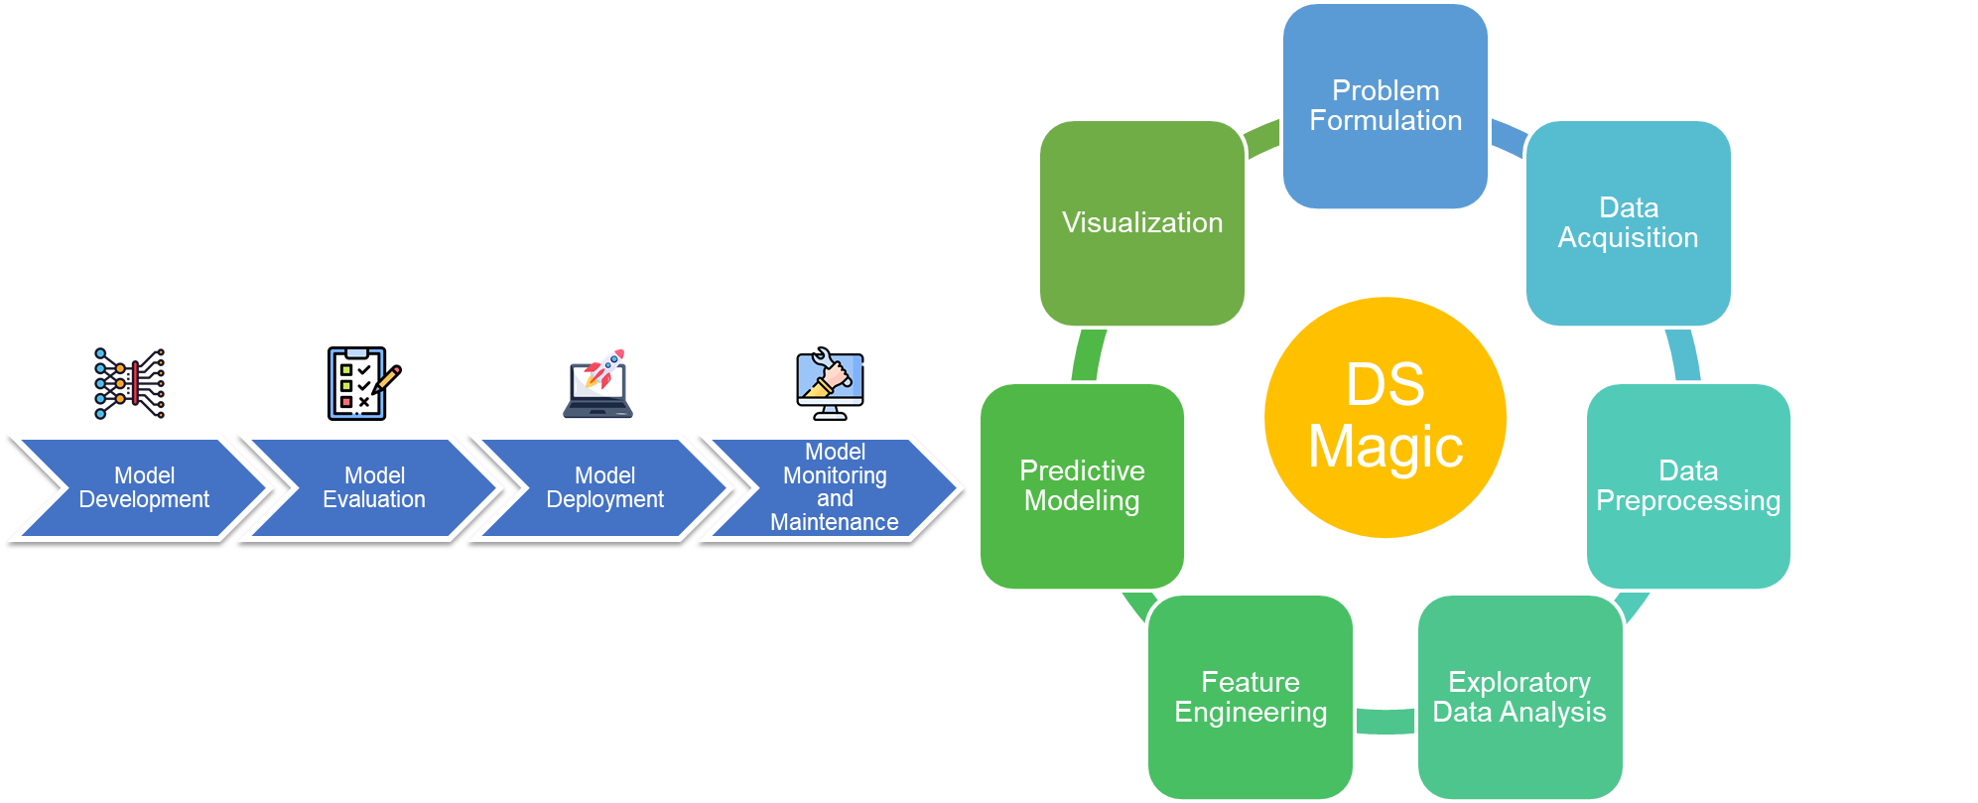
Recall!
What kind of data?
Notes:
Details:
Relevance: The data must directly address the research question or business problem you're trying to solve. If you're investigating customer behavior, data on customer transactions and interactions are relevant, while unrelated data like weather patterns might not be.
Accuracy: Data should be free from errors. For example, in a logistics company, if delivery times are recorded inaccurately, this could lead to incorrect conclusions about efficiency, leading to potential loss in customer satisfaction.
Suitability: Data should be appropriate for the analysis. For instance, using demographic data to predict buying behavior requires ensuring that the data is granular enough (e.g., age groups, income levels) to be meaningful in analysis.
Real-world Example: In healthcare, if a hospital is trying to reduce patient readmission rates, the right data would include detailed patient records, treatment history, and follow-up visit information. Data that is irrelevant (e.g., patient’s favorite color) would not help in addressing the core problem.

Slide 3
The Right Data.
What kind of data?
Data which is relevant, accurate, and suitable for your specific goals and analysis.

Slide 4
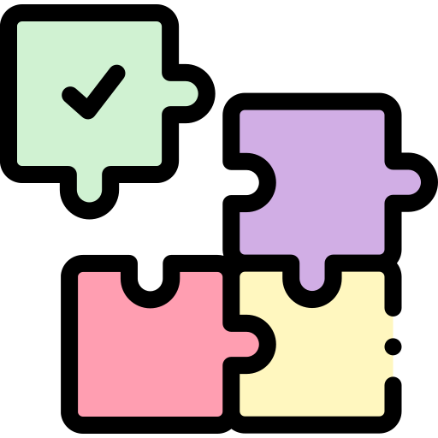

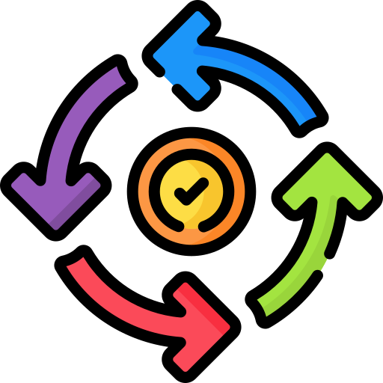


Characteristics of the Right Data
Relevance
How is the data related to the research question or problem statement?
Accuracy
Is the data free from errors, mistakes, or inconsistencies.
Completeness
Does the data include all relevant information without any missing values?
Consistency
Is the data uniform and follows a standardized format or structure?
Reliability
Can the data be trusted and depended upon for analysis and decision-making?
Notes:
Real-world Example: A tech company planning to open a new office considers several locations. They collect data on rent prices, internet speed, proximity to talent pools, and the availability of coworking spaces. They find that one location offers lower rent but slower internet speeds, which could impact productivity. By analyzing this data, they choose an office with a slightly higher rent but faster internet and closer proximity to skilled workers, ensuring a better overall environment for their operations.

Slide 5

Characteristics of the Right Data
Notes:
Real-world Example: A tech company planning to open a new office considers several locations. They collect data on rent prices, internet speed, proximity to talent pools, and the availability of coworking spaces. They find that one location offers lower rent but slower internet speeds, which could impact productivity. By analyzing this data, they choose an office with a slightly higher rent but faster internet and closer proximity to skilled workers, ensuring a better overall environment for their operations.

Slide 6
How can we identify the right data?
Step 1: Define clear objectives
Step 2: Literature review
Step 3: Consultations with domain experts
Notes:
Real-world Example: A startup wants to improve customer retention. The objective is to understand why customers churn. With this objective, they can focus on collecting data such as customer feedback, usage patterns, and service complaints, rather than gathering general demographic data that might not directly address the problem.

Slide 7
Step 1: Define clear objectives
In marketing
In healthcare
In finance
To understand the factors influencing customer purchasing decisions and develop targeted marketing strategies.
To examine the effectiveness of a new treatment method in reducing patient recovery time.
To predict stock market trends and identify profitable investment opportunities.
Provide clear direction and purpose for data collection and analysis.
Help identify the specific types of data needed to address the research questions or problems.
Notes:
Real-world Example: A startup wants to improve customer retention. The objective is to understand why customers churn. With this objective, they can focus on collecting data such as customer feedback, usage patterns, and service complaints, rather than gathering general demographic data that might not directly address the problem.

Slide 8
Step 2: Literature Review (1/2)
Reusability!
a thorough literature review can identify many relevant data sources.
Example:
"To assess the impact of climate change on global ecosystems and inform conservation strategies."
Notes:
A literature review is a summary of a subject field that supports the identification of specific research questions.
Details:
A literature review helps identify existing data and avoid duplicating efforts. It allows you to build on existing knowledge and data, ensuring that your analysis is grounded in what is already known.
Reusability: Using data from previous studies or existing databases can save time and resources.
Real-world Example: A researcher studying the impact of climate change on agriculture would review existing literature to find relevant datasets like historical crop yields, weather patterns, and soil quality data. This approach ensures that the research is built on a strong foundation of existing knowledge.

Slide 9

Step 3: Consultations with domain experts
Domain experts are individuals who possess specialized knowledge and experience in a specific field or subject area.
They can provide valuable insights, guidance, and recommendations throughout the data identification process.
Crucial to ensure the accuracy, relevance, and reliability of the obtained data.

Slide 10
What happens if we don’t assess the data quality correctly?
Data Quality Assessment
Accuracy
Consistency
Reliability
Completeness
Biased insights
Incorrect conclusions
Inaccurate predictions

Slide 11

What happens if we don’t assess the data quality correctly?

Slide 12
How can we evaluate the quality of data?

Slide 13
Statistical Analysis Techniques
Mean (μ)
μ = (x₁ + x₂ + ... + xn) / n
Median
Mode
Variance (σ²)
σ² = Σ(xᵢ - μ)² / n
Standard Deviation (σ)
σ = √(Σ(xᵢ - μ)² / n)
Percentile
The mean is the average value of a set of numbers.
The median is the middle value in a sorted dataset.
If there is an even number of observations, the median is the average of the two middle values.
The mode is the value that appears most frequently in a dataset.
Variance measures the spread or variability of a dataset.
The standard deviation is the square root of the variance.
It represents the average distance between each data point and the mean.
A percentile indicates the value below which a given percentage of data falls.
The pth percentile divides the data into two parts: p% of the data lies below the pth percentile, and (100 - p)% lies above it.

Slide 14
PSDA Cycle (Plan-Do-Study-Act)
Plan
Do
Study
Act
Set objectives, define data requirements, and plan the analysis.
Collect and analyze the data based on the defined plan.
Evaluate the results, identify areas for improvement, and refine data selection.
Implement changes, incorporate feedback, and repeat the cycle for iterative improvement.
Notes:
By continuously applying the PSDA cycle, organizations can improve the identification of the right data over time and enhance the quality of their analysis.

Slide 15
Delphi Method
Collects expert opinion using multiple rounds
Structured
Iterative process
Experts provide feedback anonymously and revise their opinions based on group consensus.
Notes:
Seek expert opinions on the relevance and suitability of data sources or variables.
Iteratively refine data selection based on expert consensus and feedback.
Details:
The Delphi method involves collecting expert opinions in multiple rounds, refining the opinions to reach a consensus. It’s anonymous and structured to avoid the influence of dominant voices.
Real-world Example: In urban planning, the Delphi method could be used to gather input from various experts (e.g., architects, environmentalists, economists) to develop a comprehensive city development plan. The iterative feedback process helps in balancing different perspectives.

Slide 16
Data Triangulation
Combine multiple data sources or methods to enhance reliability and reduce biases.
Benefits
Increased validity
cross-validation of findings
comprehensive understanding.
Qualitative (Interviews)
Data Triangulation
Quantitative (Surveys)
Expert Feedback
Example of Data Triangulation
Notes:
Reduces reliance on a single source, minimizing the risk of incomplete or biased information.
Allows for cross-validation of findings, increasing confidence in the results.
Provides a broader perspective and a more comprehensive understanding of the subject under investigation.

Slide 17
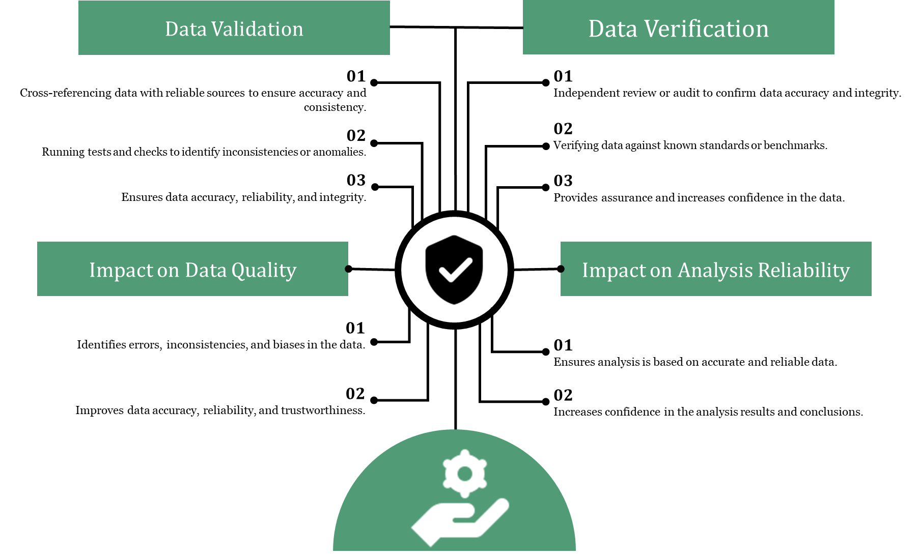
Data Validation and Verification

Slide 18
That’s a lot of work on a lot of data!

Slide 19
Sample Selection Techniques
Random sampling
Selecting a subset of data randomly to represent the entire population.

Slide 20
Sample Selection Techniques
Stratified sampling
Dividing the population into distinct groups and selecting samples from each group.
Notes:
In stratified sampling, the population is divided into subgroups or strata based on certain characteristics.
Samples are then selected from each stratum in proportion to its representation in the population.
It ensures that the sample represents the diversity of the population and allows for subgroup analysis.

Slide 21
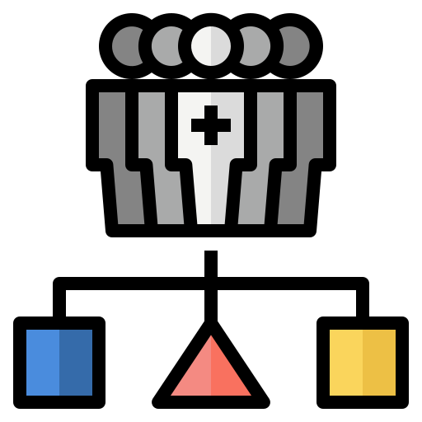
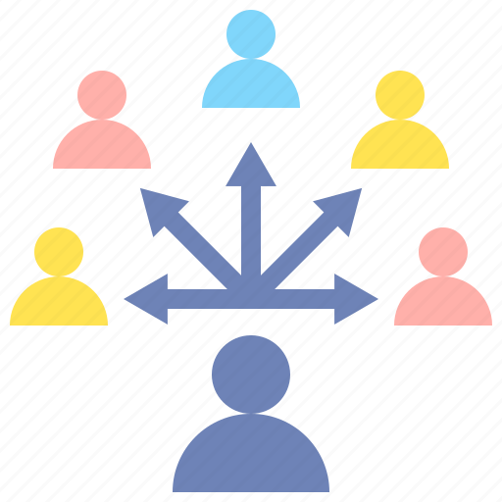
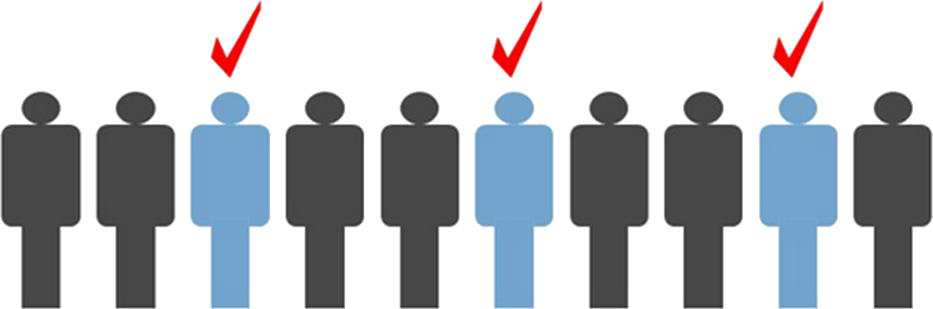
Sample Selection Techniques
Cluster sampling
Create clusters(groups) in the data
Select a cluster
Use all instances in the cluster
Systematic sampling
Select a random data instance
Then select every nth element from data
Convenience sampling
Selecting instances/data sources which are readily available or easily accessible

Slide 22
Why are we doing this?

Slide 23
Impact of Right Data on AI/ML
Enhancing model accuracy and performance
Facilitating effective decision-making
Driving innovation and competitive advantage
Notes:
AI/ML models depend on high-quality data for training, validation, and testing.
The right data improves model accuracy, reduces bias, and enhances predictive capabilities.
Accurate and relevant data enables informed decision-making in AI/ML applications.
It provides valuable insights, supports trend analysis, and helps identify patterns or anomalies.
Organizations that leverage the right data gain a competitive edge by identifying market trends, customer preferences, and new opportunities.

Slide 24
Impact of Right Data on Business
Improved customer understanding and targeting
Enhanced operational efficiency and cost reduction
Data-driven innovation and product development
Notes:
Improved customer understanding and targeting:
The right data enables businesses to understand their customers better, including preferences, behavior patterns, and buying habits.
It supports targeted marketing strategies and personalized customer experiences.
Enhanced operational efficiency and cost reduction:
Accurate data enables process optimization, resource allocation, and inventory management.
It helps identify inefficiencies, reduce waste, and improve overall operational efficiency.
Data-driven innovation and product development:
The right data provides insights for innovation, product development, and market adaptation.
It helps businesses identify emerging trends, customer needs, and areas for improvement.

Slide 25
How do we obtain the right data?

Slide 26
Obtaining the Right Data
Surveys
Experiments
Observations from the real world
Existing databases, data providers, and open data sources
Other methods
Controlled experiments
Focus groups
Case studies
Questionnaires
Interviews
A/B testing

Slide 27
Wrong Data and its Impact
Incorrect insights
flawed conclusions
biased predictions
Inaccurate data
Example: Recording incorrect sales figures or customer details due to human error or technical glitches.
Incomplete data
Example: Missing fields in a customer database, such as contact information or purchase history.
Biased data
Example: Biased survey responses due to sampling bias or leading questions.
contains errors, mistakes, or false information.
lacks necessary information or has missing values.
reflects a particular viewpoint or is influenced by prejudice.

Slide 28
Wrong Data and its Impact

Slide 29

Happy Learning!

